Slide 1
Integrate Docker With Selenium-C#- Mbunit framework

Slide 2
Agenda
What is Docker
Advantages
Frequently used Commands
How to hook Docker into Selenium?
Demo
Challenges

Slide 3

What is Docker??
An open source tool that can package an application and its dependencies such as libraries in a virtual container
Can run on any Linux server
Automates the deployment of applications inside software containers
YouTube Video: https://www.youtube.com/watch?v=pGYAg7TMmp0

Slide 4
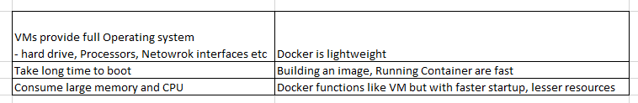
Advantages
No longer need a virtual machine spin up for each application
Greater portability (Solves the problem of Shipping code from one machine to another)
Lesser resources
Virtual Machines Vs Docker

Slide 5
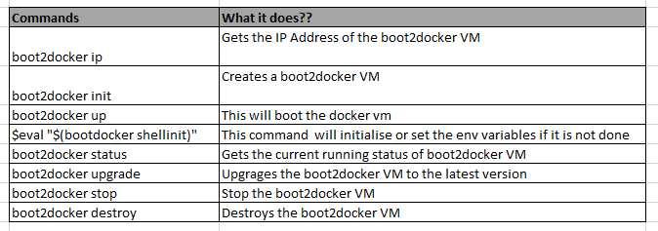
Boot2Docker Commands:
Docker sits on top of Linux kernel and inorder to access it from Windows or Mac OS , we need to install boot2docker
Download Location:
https://github.com/boot2docker/windows-installer/releases
Notes:
Docker sits on top of linux kernal.
Boot2 docker is a lightweight linux distribution made to run Docker Containers. It runs completely from RAM
Environment Variables:
Name: DOCKER_CERT_PATH
Value: C:\Users\XXX\.boot2docker\certs\boot2docker-vm
Name: DOCKER_HOST
Value: tcp://192.168.59.103:2376
Name:DOCKER_TLS_VERIFY
Value: 1

Slide 6
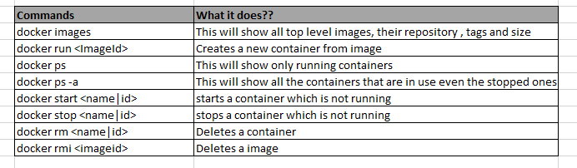
Docker Commands
Once the boot2docker VM is up and running , you can use the below commands
Command list:
https://docs.docker.com/reference/commandline/run/

Slide 7
Hook Docker into Selenium
Download the Images to your local:
Hub (Server):
docker pull selenium/hub:latest
Nodes (Browsers):
docker pull selenium/node-chrome:2.44.0
docker pull selenium/node-chrome:2.45.0
docker pull selenium/node-chrome:latest
docker pull akeem/selenium-node-phantomjs
Export the images to an archive(.tar file) if needed
docker save -o ~/Downloads/docker_selenium_hub.tar selenium/hub
docker save –o ~/Downloads/docker_selenium_node_chrome.2.46.0.tar selenium/node-chrome:2.46.0
Load the images from the .tar file
docker load --input ~/Downloads/docker_selenium_hub.tar
All these images are maintained by Selenium development team
https://github.com/SeleniumHQ/docker-selenium
https://hub.docker.com/

Slide 8
Running the Selenium Grid/Node
Start your Selenium Grid (Registering the Hub and the Nodes)
docker run -d -p 4444:4444 --name selenium-hub selenium/hub
docker run -d --link selenium-hub:hub selenium/node-chrome:2.45.0
docker run -d --link selenium-hub:hub akeem/selenium-node-phantomjs
Verify if your grid is running
bootdocker ip (192.168.59.103)
http://192.168.59.103:4444/grid/console

Slide 9
Demo
Run a Sample UI acceptance test by pointing the hub address to be boot2docker ip address
Github: Project Url
https://github.com/sujithvakathanam/Docker-C--MbunitFramweork-for-UI-acceptance-Test

Slide 10
Challenges
Legacy app with too many dependencies and complexities may not be suitable
Still in the Early phase
Latency between boot2docker and Linux kernel
Eg:Starting or Stopping or Removing a container do have latency issues

Slide 11
Q & A???

